Slide 1

Business Insights
IF% IS LAGGING 23.73% FROM TARGET
OT% IS LAGGING 27.05% FROM TARGET
OTIF% IS LAGGING 36.89% FROM TARGET

Slide 2
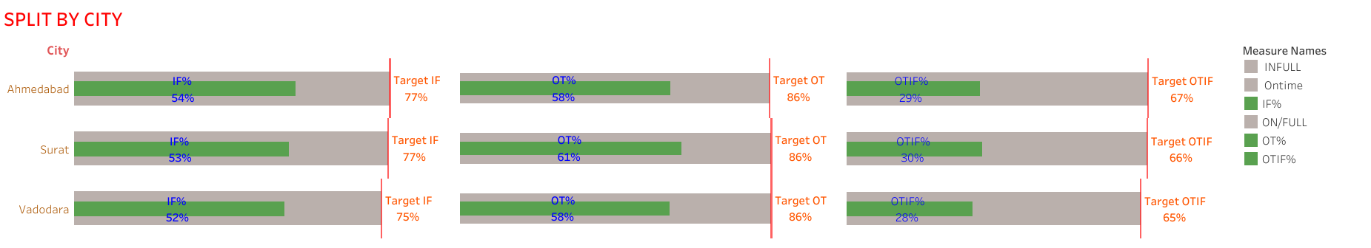
CITY WISE IF%,OT% AND OTIF% ARE ALMOST SAME

Slide 3
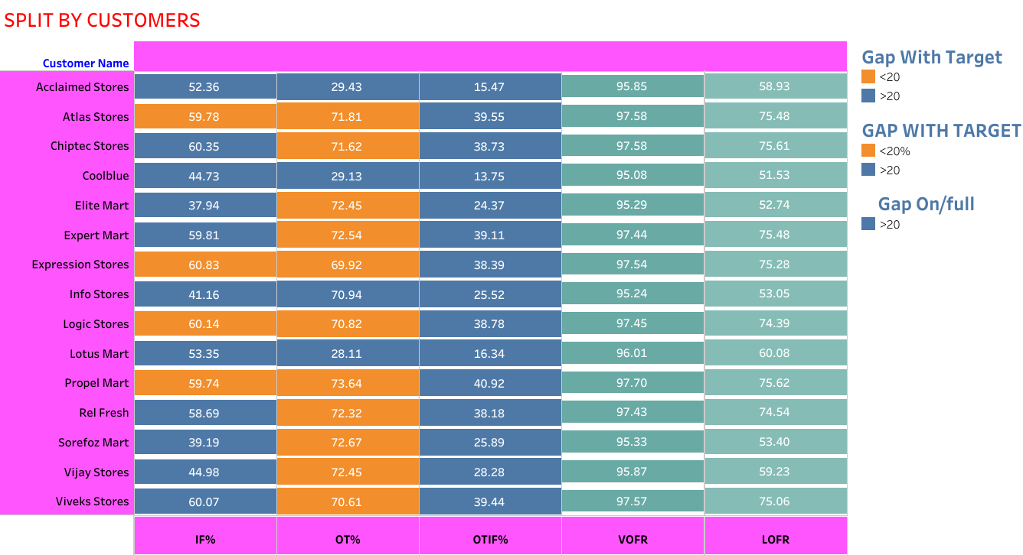
If the gap with Target is More Than 20% It is Highlighted In Blue color If The Gap with Target less than 20% It is Highlighted In Orang Color
Attentions:Acclaimed stores,coolblue and Lotus Mart with the Low OTIF%

Slide 4
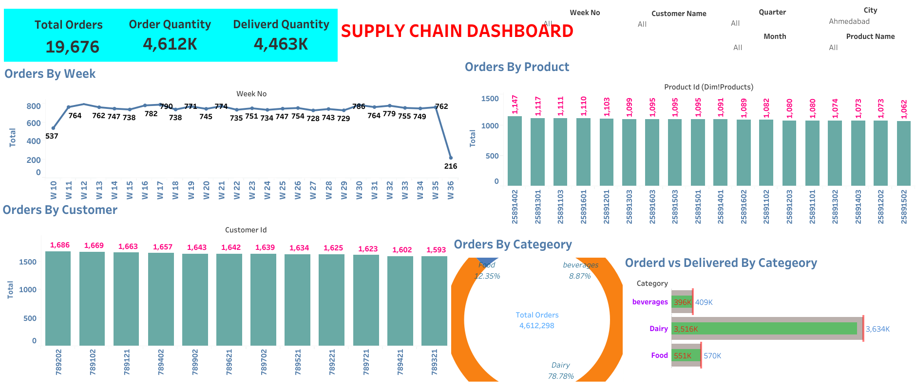
City wise Analysis:Ahemadabad

Slide 5
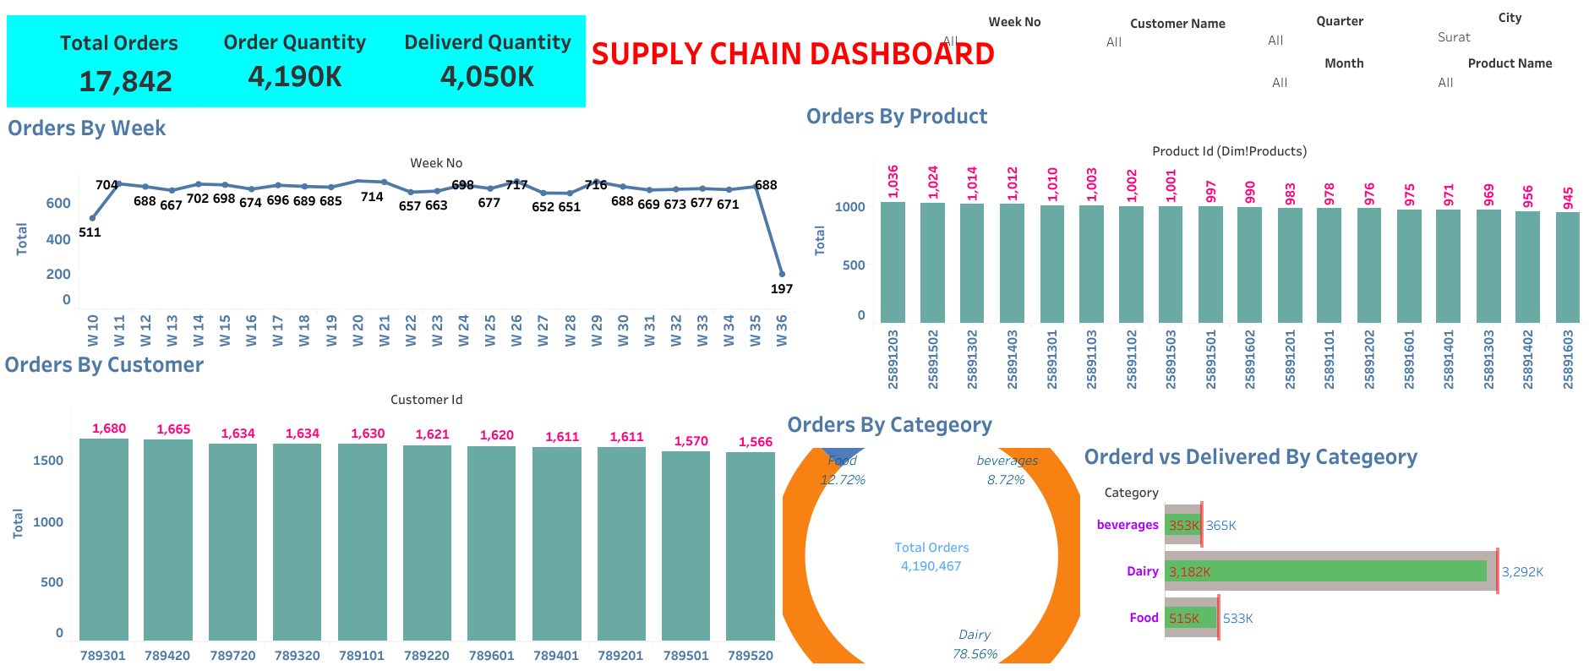
City wise Analysis:Surat

Slide 6
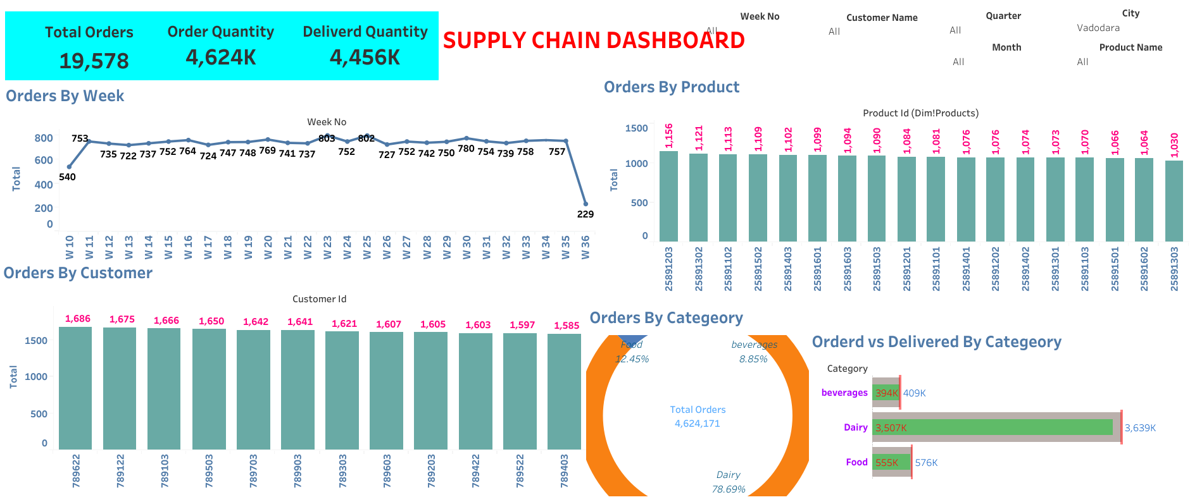
City wise:Vadodara

Slide 7
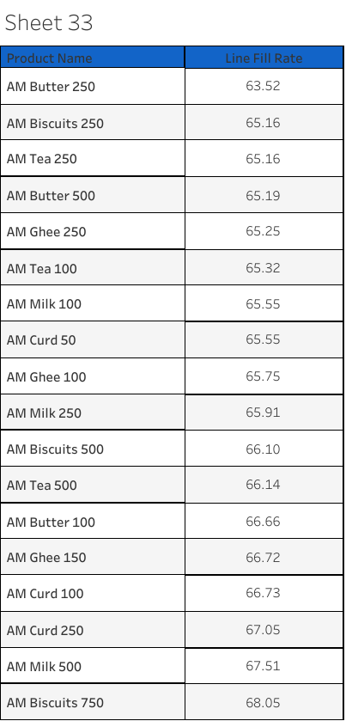
Product wise Line Fill Rate

Slide 8
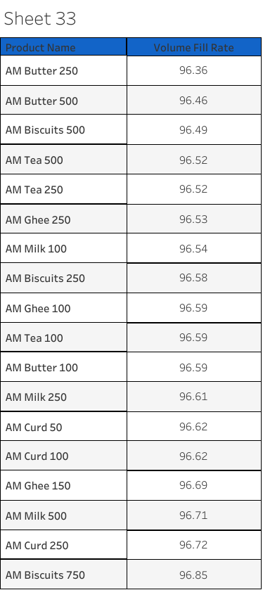
Product Wise Volume Fill Rate

Slide 9
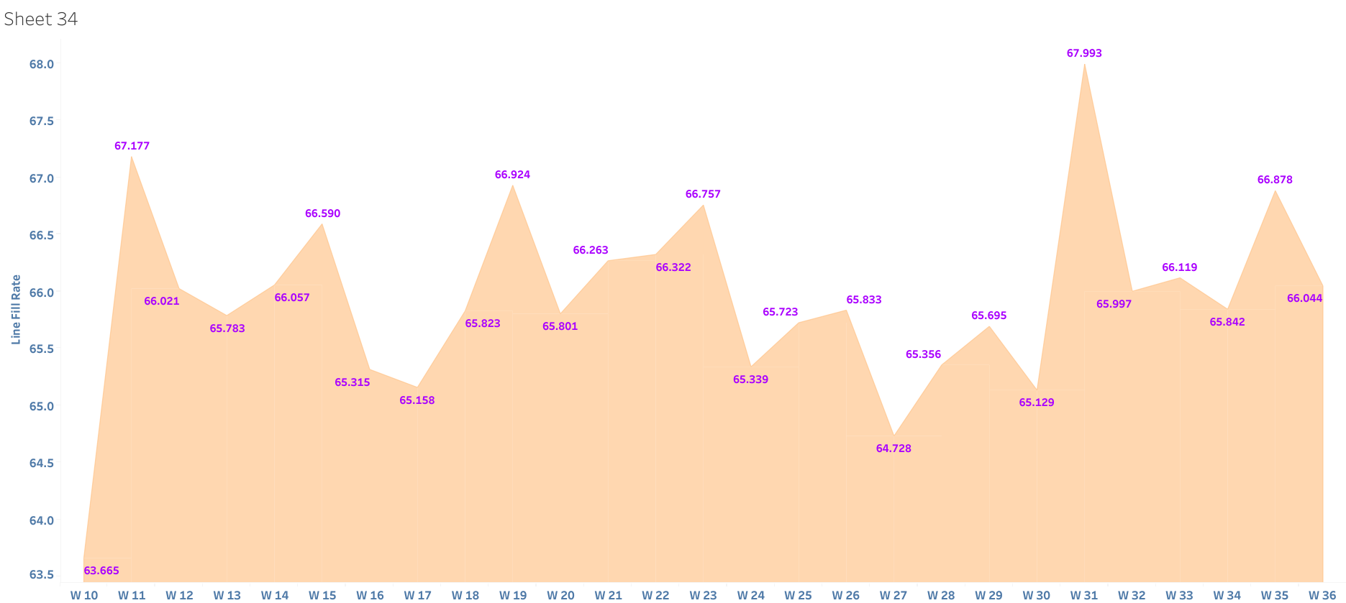
Week Wise Line Fill Rate

Slide 10
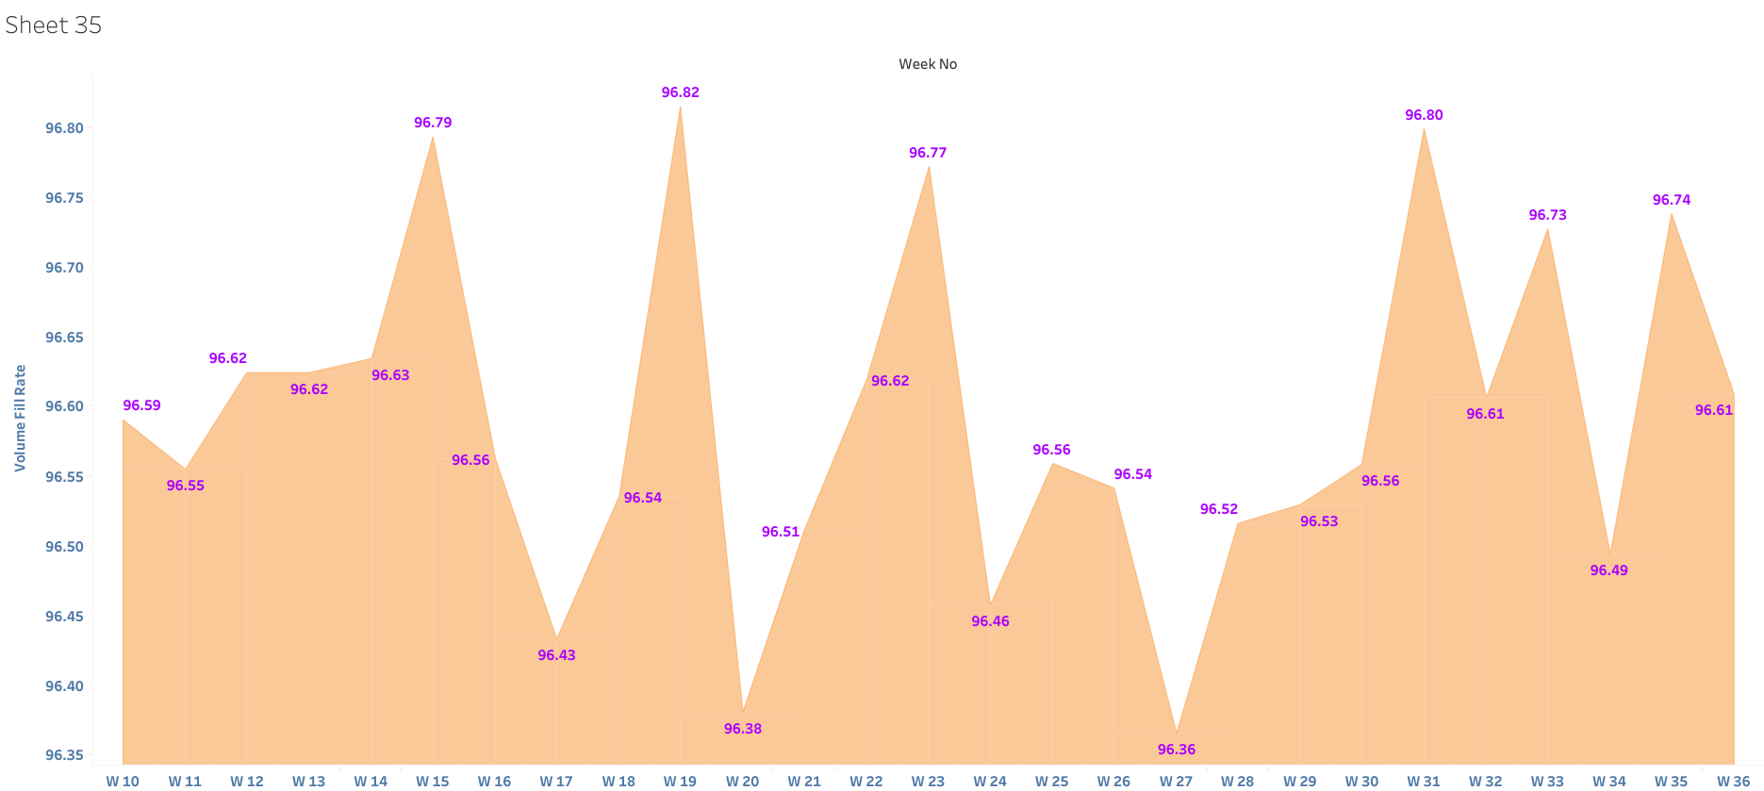
Week Wise Volume Fill Rate

Slide 11
Problem Statement: AtliQ Mart is a growing FMCG manufacturer headquartered in Gujarat, India. It is currently operational in three cities Surat, Ahmedabad and Vadodara. They want to expand to other metros/Tier 1 cities in the next 2 years. AtliQ Mart is currently facing a problem where a few key customers did not extend their annual contracts due to service issues. It is speculated that some of the essential products were either not delivered on time or not delivered in full over a continued period, which could have resulted in bad customer service. Management wants to fix this issue before expanding to other cities and requested their supply chain analytics team to track the ’On time’ and ‘In Full’ delivery service level for all the customers daily basis so that they can respond swiftly to these issues. The Supply Chain team decided to use a standard approach to measure the service level in which they will measure ‘On-time delivery (OT) %’, ‘In-full delivery (IF) %’, and OnTime in full (OTIF) %’ of the customer orders daily basis against the target service level set for each customer.

Slide 12
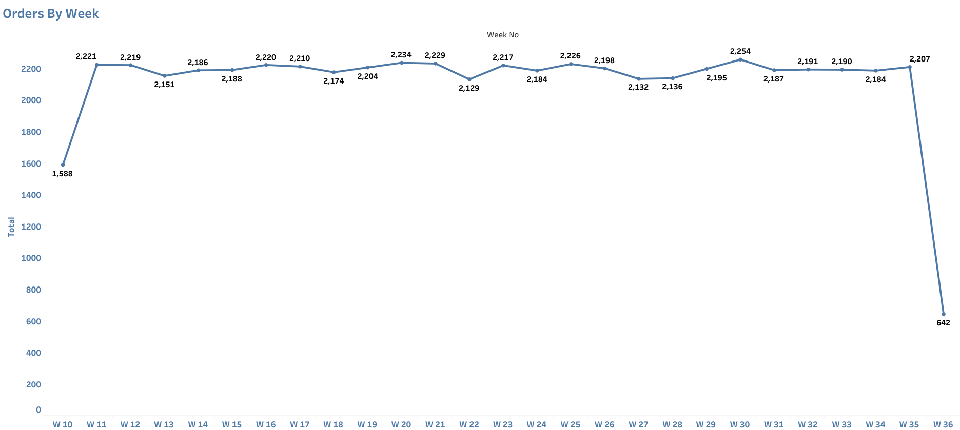
From week35 to week 36 Orders Are Decreased Drastically

Slide 13
ANALYSIS: Orders Are Drastically Decreased In Week36.I compared if%,ot%,otif%,Line fill Rate and Volume Fill Rate from w10 to w34.They are Almost Same with 1% to 2% Change.Orders Are Decreased In August In w36.I compared last 2 months(June,July) to August.it is almost Same with 1 to 2% Change.Ovearll we are Lagging In OT%,IF%,OTIF%.Better IF%,OT%,OTIF% Will Increase The Orders

Slide 14
Links To Dashboards
IF%,OT%,OTIF% By Customers And City
https://public.tableau.com/views/supplyChain/Dashboard1?:language=en-US&publish=yes&:display_cou
nt=n&:origin=viz_share_link

Slide 15
Links To Dashbaord
Line Fill Rate,Volume Fill Rate By product,Performance Over Time
https://public.tableau.com/shared/KPXHN925W?:display_count=n&:origin=viz_share_link

Slide 16
Link To Dashboard
Orders
https://public.tableau.com/shared/Q9BS9PCG2?:display_count=n&:origin=viz_share_link

